Slide 1
Gun Violence in USA
Names here
GW Data Analytics
2018

Slide 2
Motivation & Summary
Core message/hypothesis:
Gun violence will vary by region and there is no correlation with time of the year
Questions
In which state is gun violence the highest?
In which city is gun violence the highest?
Does gun violence rise during different times of the year?
Purpose:
To better understand gun violence in USA
Findings:
Xxx
xxxx

Slide 3
Questions & Data
Questions:
How many people were killed or injured by guns in 2017?
In which states and cities is gun violence the highest?
Does gun violence rise during different times of the year?
Sources:
https://www.kaggle.com/jameslko/gun-violence-data
The data set is downloaded from gunviolencearchive.org, a non-profit dedicated to providing public data on gun violence.

Slide 4
Data cleanup & exploration

Slide 5
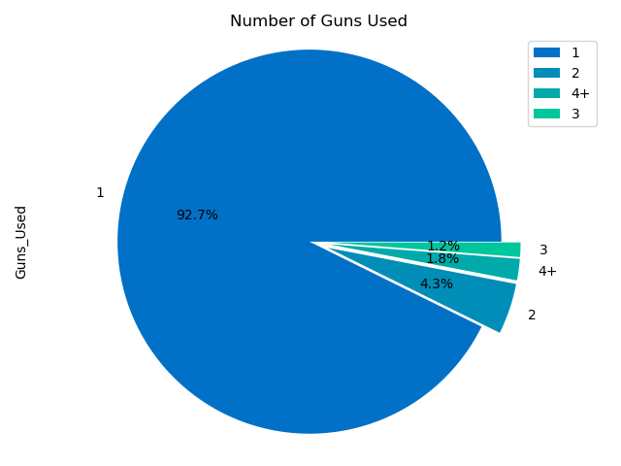
Data analysis
How many guns were used?

Slide 6
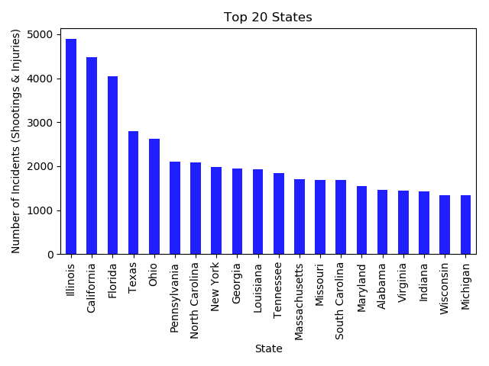
Data analysis
In which state is gun violence the highest?

Slide 7
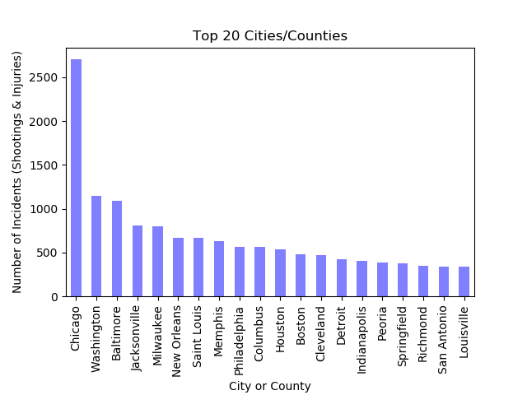
Data analysis
In which CITY is gun violence the highest?

Slide 8
discussion

Slide 9
Post mortem
Difficulties
Graphs were difficult to construct
Additional Questions
Multi-year analysis
Focusing on a smaller set of case studies like comparing states with varying gun laws
Analysis of other fields (gender, whether gun was procured illegally or legally)

Slide 10
questions

